Slide 1
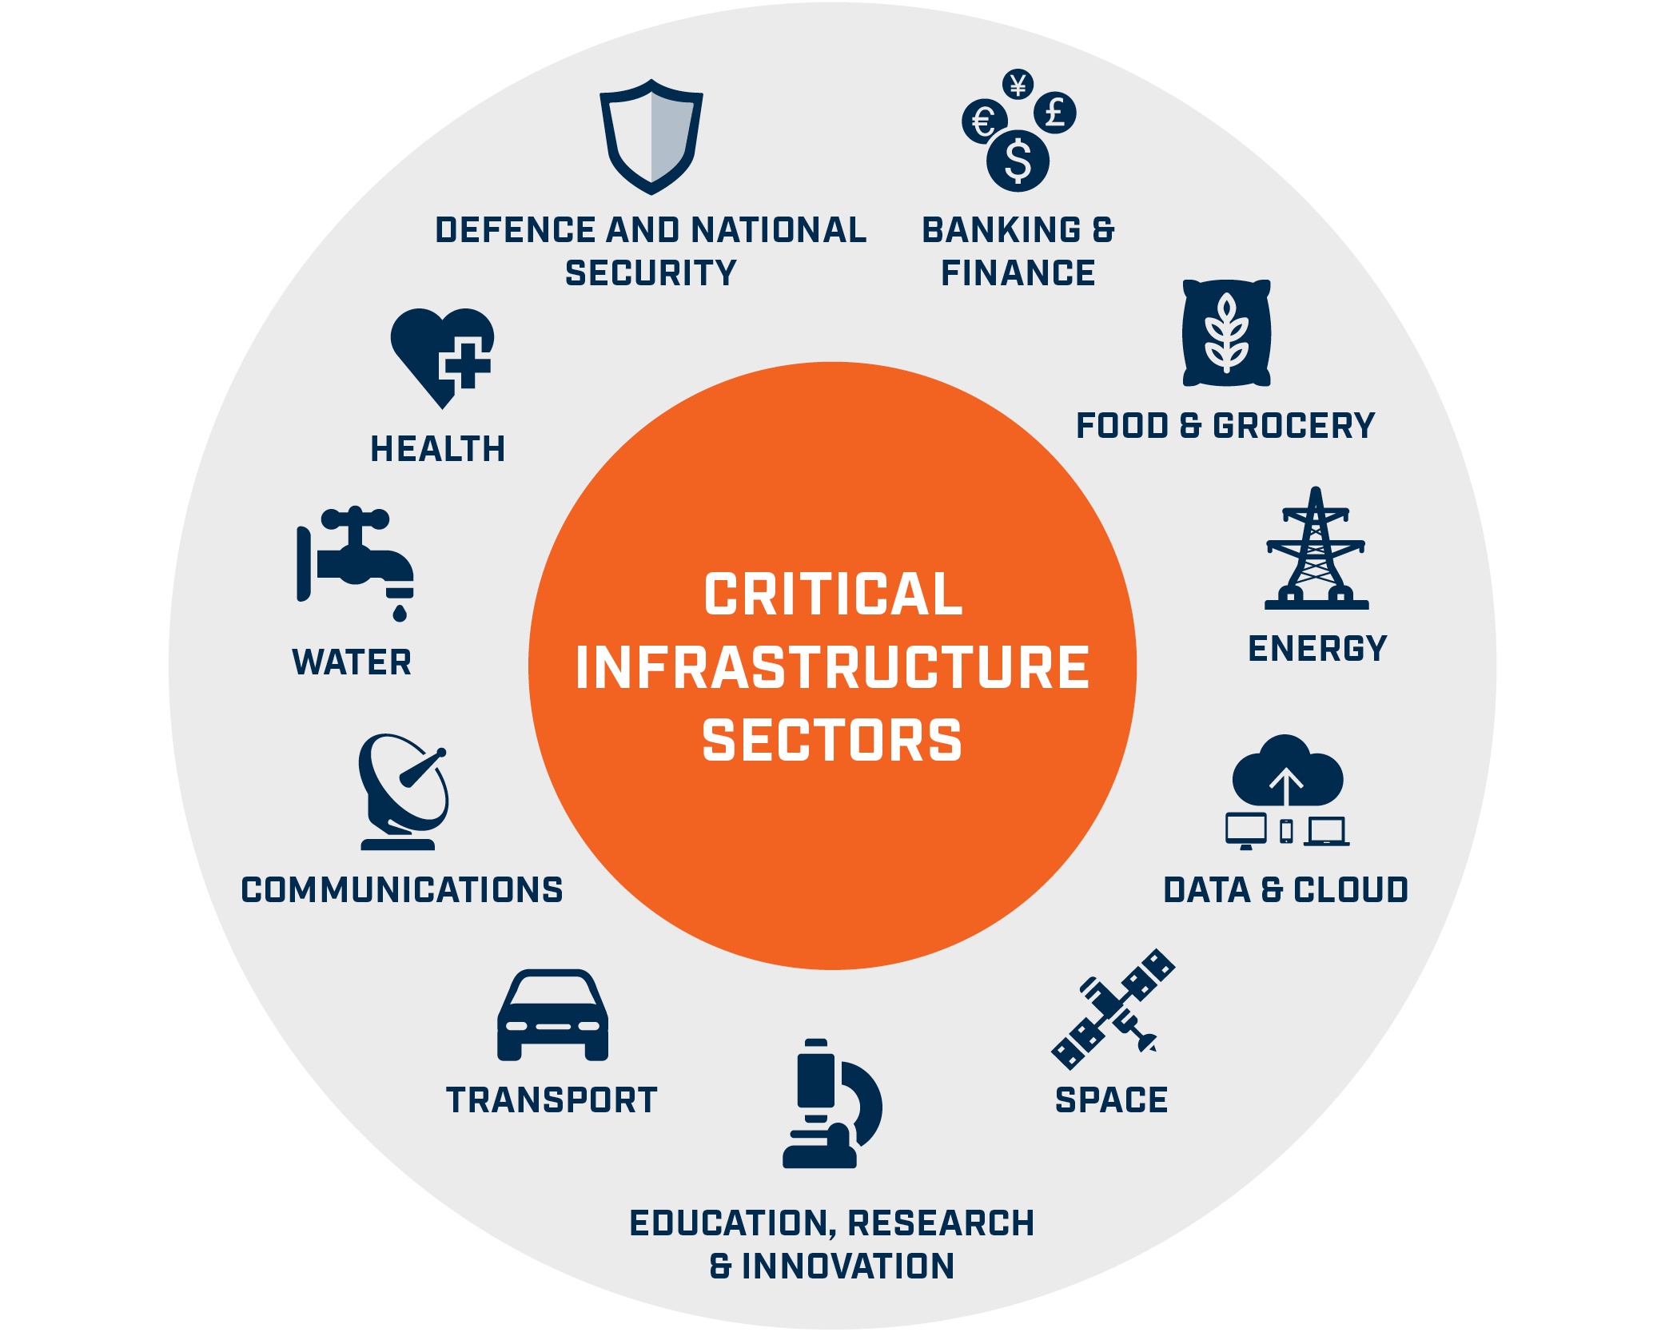
Critical Infrastructure Protection in Europe
Prof. Dr. Mitat Çelikpala

Slide 2
What is Critical Infrastructure?
CIS are the assets, systems and networks, whether physical or virtual, so vital to the state that their incapacitation or destruction would have a debilitating effect on security, national economic security, public health or safety, or any combination thereof.
Notes:
Critical infrastructures are those physical and information technology facilities, networks, services and assest which, if disrupted or destroyed, would have a serious impact on the health, safety, security or economic well-being of citizens or the effective functioning of governments. From energy systems that power our neighborhoods, to transportation networks that move us around our communities and the country, to facilities that provide our families with safe drinking water, critical infrastructure and key resources impacts nearly every aspect of our daily lives.
In short, CIKR is an umbrella term referring to; the assets of country’s essential to the nation's security,
public health and safety,
economic vitality, and
way of life.

Slide 3
Critical Infrastructure: Sectors
Energy installations and networks,
Communications and information technology,
Finance,
Health Care,
Food,
Water,
Transport,
Production, storage and transport of dangerous goods,
Government,

Slide 4
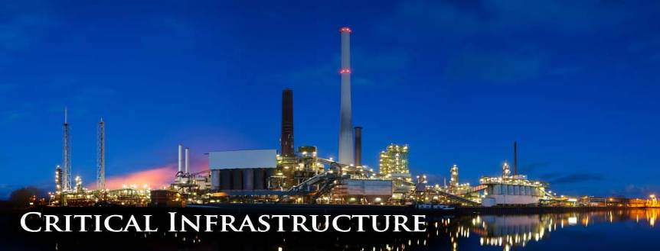
Why is Critical Infrastructure Important?
Disrupt the functioning of government and business alike,
Profound damage to public,
Widespread utility outages,
Widespread cascade effect: failure to failure,
Produce catastrophic losses,
The potential for catastrophic terrorist threat,
With WMD more devastating.
Notes:
Why is CIKR Protection Important?
Attacks on CIKR could significantly disrupt the functioning of government and business alike and produce cascading effects far beyond the targeted sector and physical location of the incident.
Direct terrorist attacks and natural, manmade, or technological hazards could produce catastrophic losses in terms of human casualties, property destruction, and economic effects, as well as profound damage to public morale and confidence.
Attacks using components of the CIKR as weapons of mass destruction could have even more devastating physical and psychological consequences.
The potential for catastrophic terrorist attacks that affect critical infrastructures is increasing. The consequences of an attack on the industrial control systems of critical infrastructure could vary widely. It is commonly assumed that a successful cyber attack would cause few, if any, casualties, but might result in loss of vital infrastructure service. For example, a successful cyber-attack on the public telephone switching network might deprive customers of telephone service while technicians reset and repaired the switching network. An attack on a chemical or liquid natural gas facility's control systems might lead to more widespread loss of lives as well as significant physical damage.
Another type of catastrophic infrastructure failure might be when one part of the infrastructure leads to the failure of other parts, causing widespread cascade effect. Such failure might occur due to the synergistic effect of infrastructure industries on each other. A simple example might be an attack on electrical utilities where electricity distribution was disrupted; sewage treatment plants and waterworks could also fail, as the turbines and other electrical apparatuses in these facilities might shut down.
Cascade events can be very damaging too, causing widespread utility outages. The blackouts for example have put in evidence the vulnerability of energy infrastructures and consequently the need to find effective measures to prevent/or to mitigate the consequences derived from a major supply disruption. This use of cyber-terrorism could also result in an amplification of the physical attack's effects. An example of this might be a conventional bombing attack on a building combined with a temporary denial of electrical or telephone service. The resulting degradation of emergency response, until back-up electrical or communication systems can be brought into place and used, could increase the number of casualties and public panic.
The potential for catastrophic terrorist attacks that affect critical infrastructures is increasing. The consequences of an attack on the industrial control systems of critical infrastructure could vary widely. It is commonly assumed that a successful cyber attack would cause few, if any, casualties, but might result in loss of vital infrastructure service. For example, a successful cyber-attack on the public telephone switching network might deprive customers of telephone service while technicians reset and repaired the switching network. An attack on a chemical or liquid natural gas facility's control systems might lead to more widespread loss of lives as well as significant physical damage.
Another type of catastrophic infrastructure failure might be when one part of the infrastructure leads to the failure of other parts, causing widespread cascade effect. Such failure might occur due to the synergistic effect of infrastructure industries on each other. A simple example might be an attack on electrical utilities where electricity distribution was disrupted; sewage treatment plants and waterworks could also fail, as the turbines and other electrical apparatuses in these facilities might shut down.
Cascade events can be very damaging too, causing widespread utility outages. The blackouts for example have put in evidence the vulnerability of energy infrastructures and consequently the need to find effective measures to prevent/or to mitigate the consequences derived from a major supply disruption. This use of cyber-terrorism could also result in an amplification of the physical attack's effects. An example of this might be a conventional bombing attack on a building combined with a temporary denial of electrical or telephone service. The resulting degradation of emergency response, until back-up electrical or communication systems can be brought into place and used, could increase the number of casualties and public panic.

Slide 5
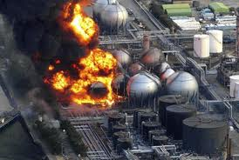
How to Identify and Prioritize?
Given: Not all infrastructure can be protected at all times:
Identification
Measurement
Controlling
According to:
Scope
Magnitude
Time
Psychological Effect
Notes:
US alone 77.000 dams and reservoirs and 3.200.000 km + pipelines

Slide 6
Threats: Malignant Forces
Critical support failure of aging steel, concrete or other material ,
Structures weakened by hurricanes, earthquakes or other natural events ,
Structures weakened by overuse, or usage that exceeds the original design specifications ,
General failures in technology, systems or processes
Notes:
Malignant Forces are mostly natural forces that deteriorate infrastructure. These are the relentless forces of time, weather and neglect, and include:
• Critical support failure of aging steel, concrete or other material
• Structures weakened by hurricanes, earthquakes or other natural events
• Structures weakened by overuse, or usage that exceeds the original design specifications
• General failures in technology, systems or processes

Slide 7
Threats: Malevolent Forces
Terrorist organizations,
Elements working on behalf of a competitive foreign power ,
Individuals with malicious intent towards the government, or towards a particular business or organization, who are “super-empowered” by modern information, communications, and other technologies
Notes:
Malevolent Forces are the external forces that threaten to physically attack and disrupt the normal operation of infrastructure. These threats include:
• Terrorist organizations, both foreign and domestic
• Elements working on behalf of a competitive foreign power
• Individuals with malicious intent towards the government, or towards a particular business or organization, who are “super-empowered” by modern information, communications, and other technologies

Slide 8
Protection: What to do?
Promote a broad understanding of public-private security cooperation,
Analysis: investment in Horizon scanning, early warning, risk analysis, intelligence gathering and dissemination,
Strategy: Development of security strategies,
Operations: Crises prevention, crisis management, post-crisis stabilization and consequence management,
Preparation: Training and education, research and development, procurement, financing.
Coordination between the government and private sector,
Too centralized infrastructure,
Crumbling infrastructure,
Cyber Interdependency.
Notes:
Energy Infrastructure is a network of systems
Any disruption has the potential to trigger a cascade of network failures
Globalisation and deregulation have amplified the opportunity for terrorist and other criminally minded groups to initiate attacks and disruption
It is vital to mitigate risks to energy infrastructures by investing in the entire energy supply chain
Such investment will then be directed to mitigating attacks (terrorist and criminal), natural catastrophes and accidents
This investment must be targeted at CRITICAL energy infrastructure
To increase infrastructure situational awareness, private sector energy infrastructure operators and owners should communicate regularly, comprehensively and transparently
Public authorities should ensure that information regarding threats is communicated in a full and timely manner to private sector operators and owners
Energy Infrastructure is a network of systems
Any disruption has the potential to trigger a cascade of network failures
Globalisation and deregulation have amplified the opportunity for terrorist and other criminally minded groups to initiate attacks and disruption
It is vital to mitigate risks to energy infrastructures by investing in the entire energy supply chain
Such investment will then be directed to mitigating attacks (terrorist and criminal), natural catastrophes and accidents
This investment must be targeted at CRITICAL energy infrastructure
To increase infrastructure situational awareness, private sector energy infrastructure operators and owners should communicate regularly, comprehensively and transparently
Public authorities should ensure that information regarding threats is communicated in a full and timely manner to private sector operators and owners

Slide 9
Best Examples
March 11, 2011 at 2:46 in the afternoon Japan time, one of the most powerful earthquakes ever recorded,
55 minutes later a huge tsunami unleashed,
A nuclear accident: explosion damaged the plants, radiation was released,

Slide 10
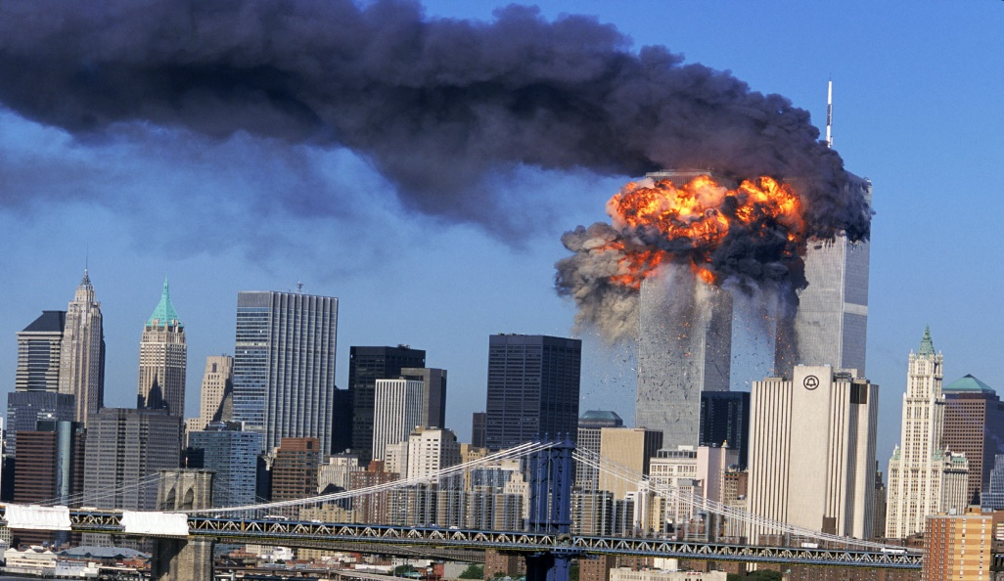
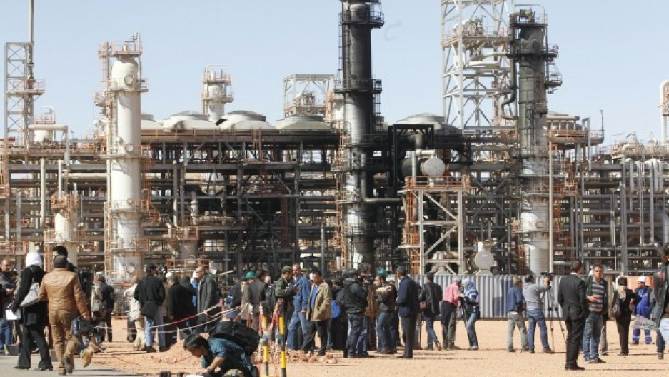
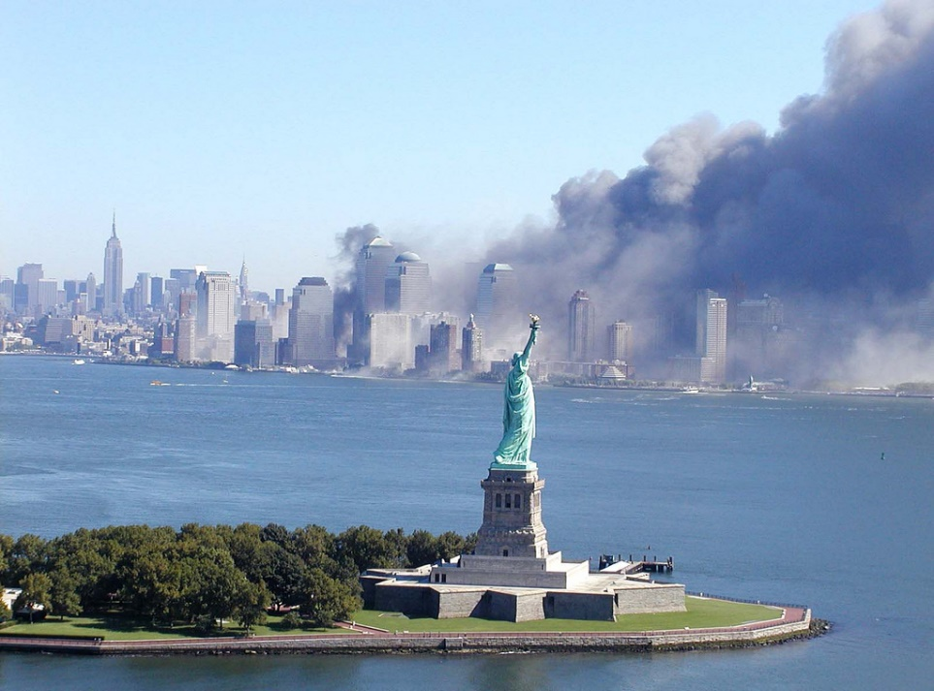
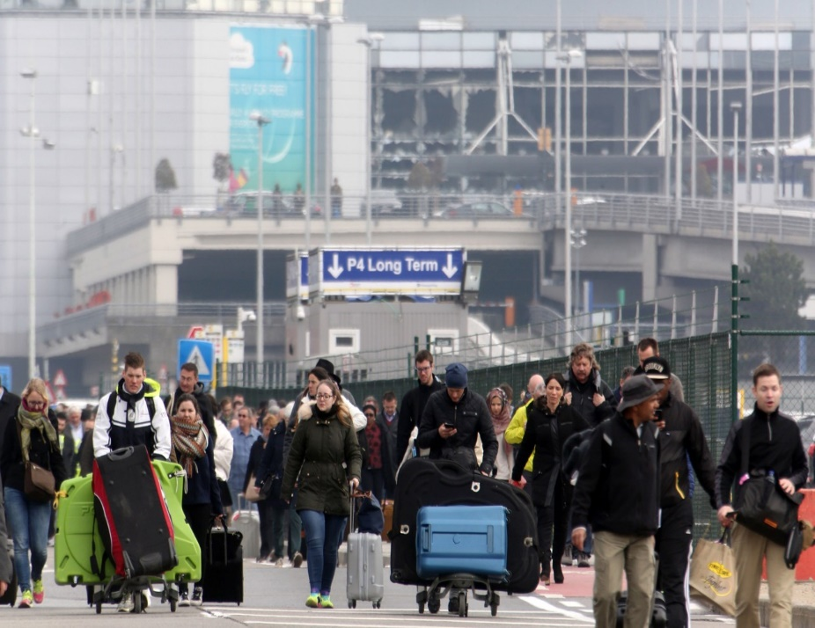
Sept. 11 attacks on New York City and Pentagon, Madrid and London attacks, Istanbul and Brussells airport attacks, Algeria Al-Qaida attacks, terrorist attacks in Pakistan, attack on Abqaiq refinery in Saudi Arabia, Truck-bomb attack on power station in Algeria…

Slide 11
Regulatory Framework: Some Examples
The US: Homeland Security PD-7 (2003) Critical Infrastructure Identification, Prioritization, and Protection,
NATO Parliamentary Assembly Special Report on “The Protection of Critical Infrastructure» (2007), “Energy Security” and “Civil Emergency Planning”
UN General Assembly Resolution A/RES/58/199 on “Creation of a global culture of cybersecurity and the protection of critical information infrastructures”.
UN Counter-Terrorism Implementation Task Force (CTITF) Working Group on PCI54
UNSC Resolution 2341 Threats to International Peace and Security caused by Terrorist Acts (2017),
Inter-American Committee Against Terrorism of the Organization of American States (OAS/ CICTE), “Protection of Critical Infrastructure against Emerging Threats” and “Tourism Security Programme”,
INTERPOL Major Event Support Teams (IMEST) and INTERPOL Incident Response Teams (IRT),
OSCE “Non-Nuclear Critical Energy Infrastructure Protection from Terrorist Attacks”
Regional Cooperation Council “Integrated Infrastructure Planning”.

Slide 12
European Program for Critical Infrastructure Protection-EU COM786
European Programme for Critical Infrastructure Protection (EPCIP): “designates European critical infrastructure that, in case of fault, incident or attack, could impact both the country where it is hosted and at least one other EU member State. Member states are obliged to adopt the 2006 directive into their national statutes.”
European Network and Information Security Agency (ENISA),
A Critical Infrastructure Warning Information Network (CIWIN)
Notes:
As a complement to the measures that have been taken at national level, the EU has already adopted a number of legislative measures setting minimum standards for infrastructure protection in the framework of its different policies. This is notably the case in the transport, communication, energy, occupational health and safety, and public health sectors.
A further step towards communication security is being made with the creation of the European Network and Information Security Agency (ENISA). In addition, in sectors like aviation and maritime security, inspection services have been created within the Commission to monitor the implementation of security legislation by EU countries.
A European Programme for Critical Infrastructure Protection (EPCIP) will be set up with a view to identifying critical infrastructure, analysing vulnerability and interdependence, and coming forward with solutions to protect from, and prepare for, all hazards. The programme should include helping industrial sectors to determine the terrorist threat and potential consequences in their risk assessments. EU countries’ law enforcement bodies and civil protection services should ensure that EPCIP forms an integral part of their planning and awareness-raising activities.
A Critical Infrastructure Warning Information Network (CIWIN) that brings together critical infrastructure protection specialists from EU countries. This infrastructure warning network assist the Commission in drawing up the programme.
In conclusion, the goal of EPCIP and the duty of the Commission would be to ensure that there are adequate and uniform levels of protective security on critical infrastructure, minimal points of failure and tested rapid reaction arrangements throughout the EU.

Slide 13
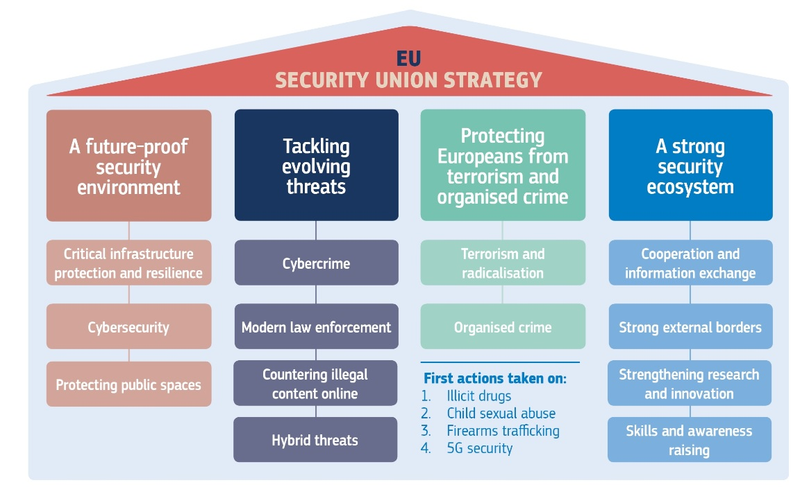
EU as a Security Union and CIP
On the 24 July 2020, the European Commission set out the new for the period 2020 to 2025,
The new Security Union Strategy is built around the following objectives:
To build capabilities and capacities for early detection, prevention and rapid response to security crisis
To focus on results
To link all players in the public and private sectors in a common effort.

Slide 14
Thanks Questions?

