Slide 1
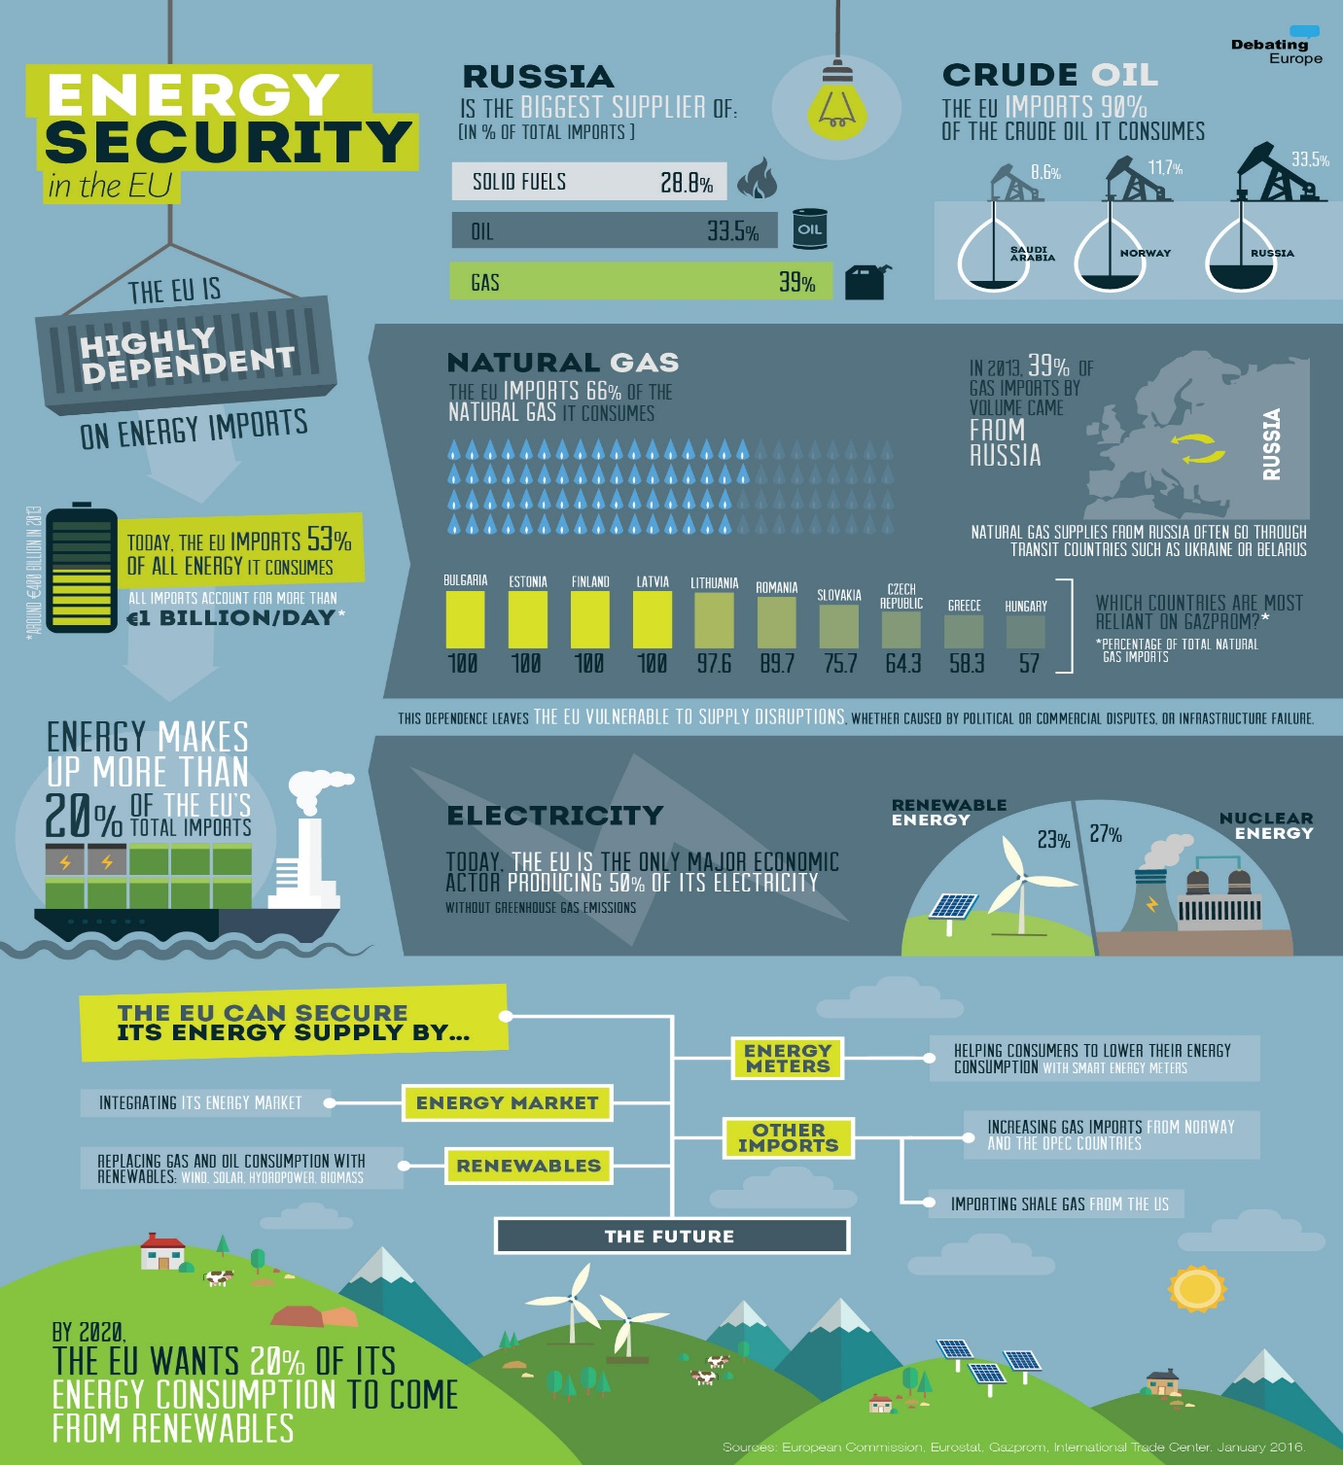
Energy Security in Europe
Prof. Dr. Mitat Çelikpala

Slide 2
Energy Security: Main Questions
Will enough energy be available to meet the needs of a growing world and at what cost and with what technologies?
How can the security of the energy system on which the world depends be protected?
What will be the impact of environmental concerns and how will energy development affect the environment?

Slide 3
Energy Security: Definition
Elusive: varies depending upon one’s position in the value chain
Consumers and energy-intensive industries,
Major oil producing countries,
Oil and gas producing countries,
Transit countries,
Developing countries,
Power companies,
Policymakers.

Slide 4
Elements of Energy Security
Availability
When a country wants energy, it should be available.
Accessibility
The nation should be able to access energy sources globally to ensure uninterrupted growth.
Affordability
The growth engine is not impacted by the price impact
Sustainability
To be able to access energy sources sustainably
Problems: Production Related; Transportation Related; Political; Economy Related; or some other.
Notes:
Energy security is essentially summarized in the following 4 elements –
Availability on demand, when a country wants energy, it should be available.
The nation should be able to access energy sources globally to ensure uninterrupted growth
Affordability of the energy being procured to ensure that the growth engine is not impacted by the price impact
4

Slide 5
What is Energy Security for the EU?
Availability
Acceptability
Affordability
Security of supply
Investments in production and transport, transmission, distribution
Sustainability
Technological innovations
Competition
Internal Market
The current definition of European energy security is in line with that of the International Energy Agency (IEA): “uninterrupted availability of energy at an affordable price.”
The European Energy Security Strategy (2014): “EU prosperity and security hinges on a stable and abundant supply of energy.”
Notes:
More narrowly, energy security is defined as Energy security:
Adequate,
affordable,
reliable,
timely,
clean and
uninterrupted supplies of energy.
Energy security matters because energy is essential to economic growth and human development.

Slide 6
The EU as an Energy Union
A Green paper was issued in 2000: “Towards a European strategy for security of energy supply,”
Another one in 2006: “A European strategy for sustainable, competitive and secure energy,”
The Third Energy Package entered into force in September 2009.

Slide 7
Building and governing the energy union
The Energy Union’s leading topics are: security, solidarity and trust: diversifying Europe's sources of energy and ensuring energy security through solidarity and cooperation between EU countries
A fully integrated internal energy market: enabling the free flow of energy through the EU through adequate infrastructure and without technical or regulatory barriers

Slide 8
The Third Energy Package
The Single European Market for energy,
Higher standards,
Unbundling,
National energy regulators across the EU,
Harmonization,
Priorities: Supply security (Diversification), A fully-integrated internal energy market (To enable increased competition and lower energy prices-affordability), Energy efficiency (Consuming less energy), Emissions reduction (new infrastructure and Technologies), Research and innovation (low-carbon technologies).
Institutions: European Agency for the Cooperation of Energy Regulators (ACER) and European Network of Transmission System Operators (ENTSO).

Slide 9
2020 and 2030 Targets
The EEA report ‘Trends and Protections in Europe 2021’ estimated that the EU achieved its three 2020 climate and energy targets:
reducing greenhouse gas emissions by 20% compared to 1990 levels,
increasing the share of renewble energy use to 20%,
improving energy efficiency by 20%.
Key targets for 2030:
At least 40% cuts in greenhouse gas emissions (from 1990 levels),
At least 32% share for renewable energy,
At least 32.5% improvement in energy efficiency,

Slide 10
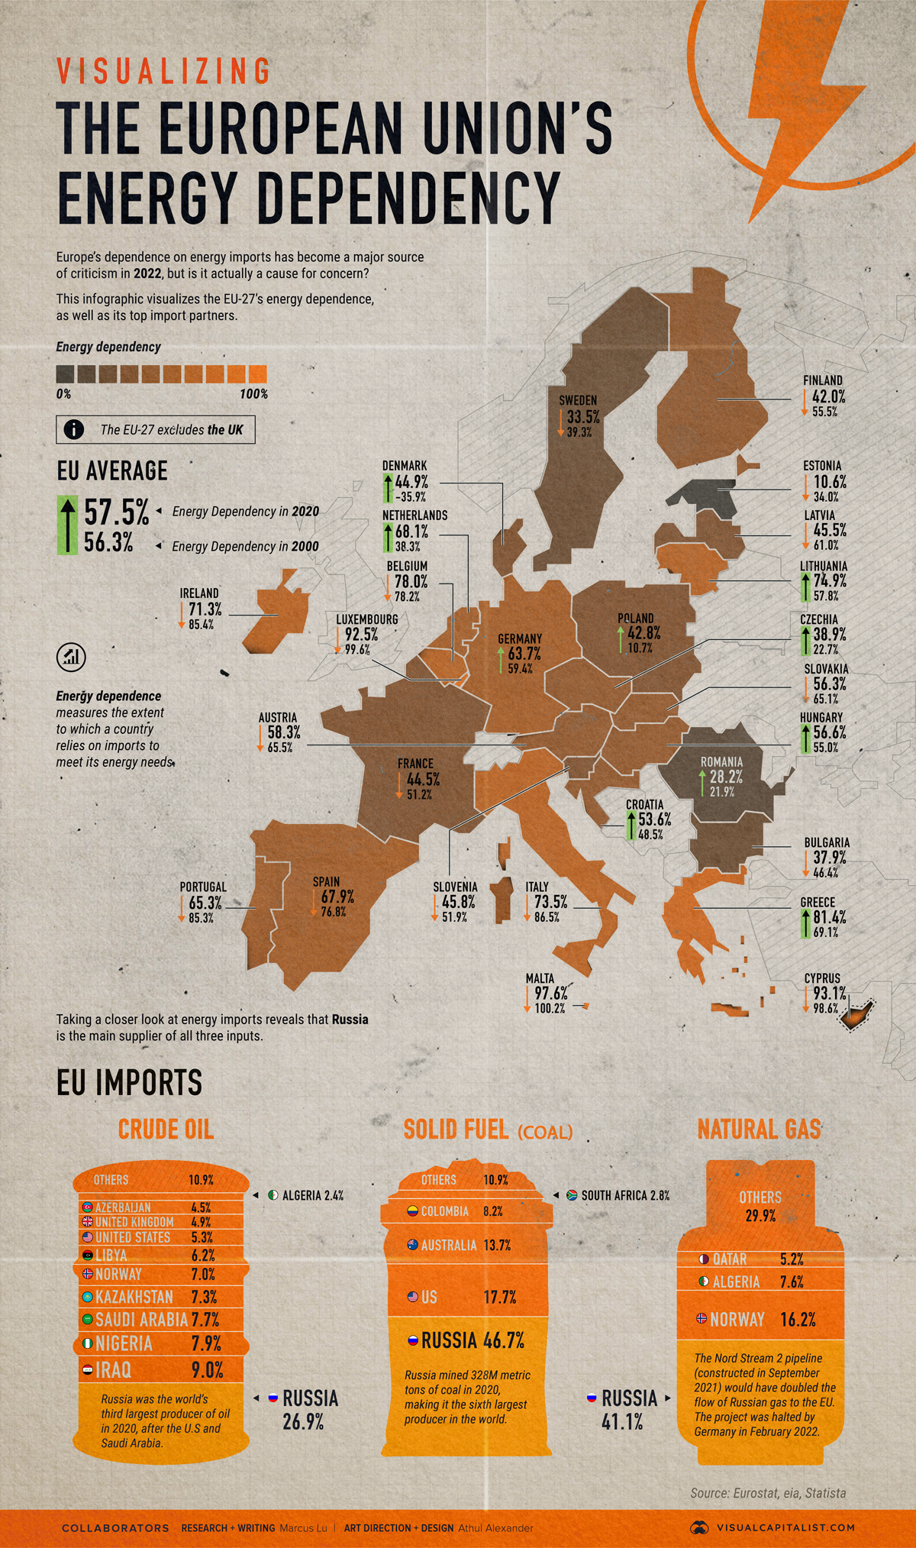
Russia as a Challenge?
Escalating dependence on handful number of supplier, especially Russian Federation.
In the last decade the EU (especially the Eastern member states) has found itself under the Russian vertical monopoly over the supply of natural gas, which discourages and undermines the European consumers' drive for diversification efforts.

Slide 11
The European Commission’ Plan (REPowerEU)
Commission President Ursula von der Leyen: “We must become independent from Russian oil, coal and gas. ...We need to act now to mitigate the impact of rising energy prices, diversify our gas supply for next winter and accelerate the clean energy transition. The quicker we switch to renewables and hydrogen, combined with more energy efficiency, the quicker we will be truly independent and master our energy system.”
Executive Vice-President for the European Green Deal, Frans Timmermans: “Let's dash into renewable energy at lightning speed. Renewables are a cheap, clean, and potentially endless source of energy and instead of funding the fossil fuel industry elsewhere, they create jobs here..”
Commissioner for Energy, Kadri Simson: “For the remaining weeks of this winter, Europe has sufficient amounts of gas, but we need to replenish our reserves urgently for next year. The Commission will therefore propose that by 1 October, gas storage in the EU has to be filled up to at least 90%.”

Slide 12
Joint Statement between the EC and the US on European Energy Security
Reducing Europe’s dependency on Russian energy,
Accelerating the global transition to clean energy,
Meeting the goals of the Paris Agreement,
Establish a joint Task Force on Energy Security to set out the parameters of this cooperation and execute its implementation,

Slide 13
Challenges and Policy Conflicts
Require massive investments in LNG terminals and infrastructure; not specified how the financing will be secured,
Member states have very fragmented shale gas policies and do not agree on a common approach
Tax incentives and subsidies for unconventional fossil fuels in conflict with creating a more integrated, smoother energy market and potentially with renewable energy targets
A suggested voluntary demand aggregation mechanism for collective purchasing of gas already rejected by a majority of member states: better to pursue antitrust proceedings against Gazprom

Slide 14
Thanks, Questions?

